Slide 1
Airline Safety
Michelle Rice
DSC640-T302
Executive Summary

Slide 2
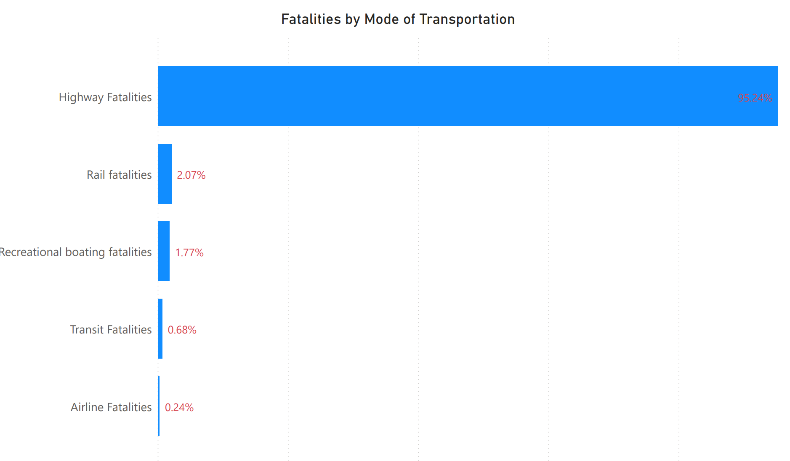
Southwest Airlines Response to Negative Press Regarding Airline Safety
Airlines are still the safest way to travel
This chart shows fatalities from 2010 – 2020 by mode of transportation. Highway fatalities accounted for 95.24% of fatalities while airlines accounted for only .24%

Slide 3
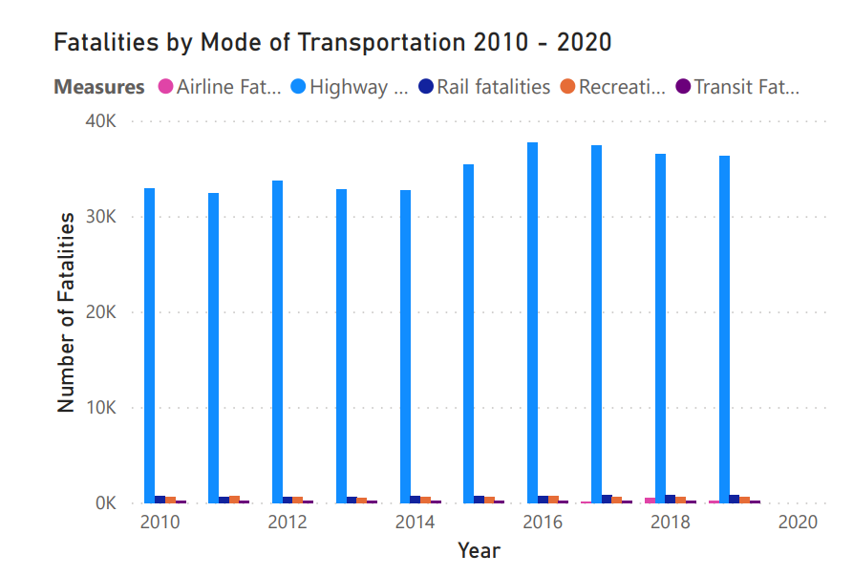
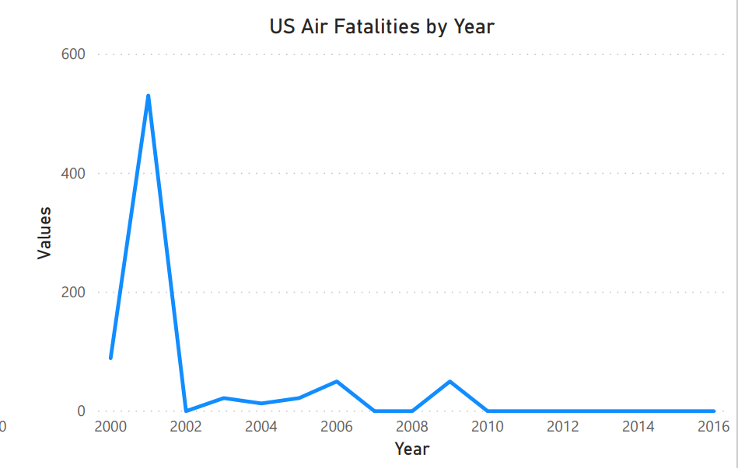
Air vs. highway travel
Looking at the fatalities by mode of transportation year over year, we can again see that highway fatalities by far out weigh any other method of travel. We can also see that the number of highway fatalities has remained steady and even went slightly up around 2016. Looking at airline fatalities over time, we see a few upticks when there are large incidents (especially around 9/11) but overall the pattern is low and flat.

Slide 4
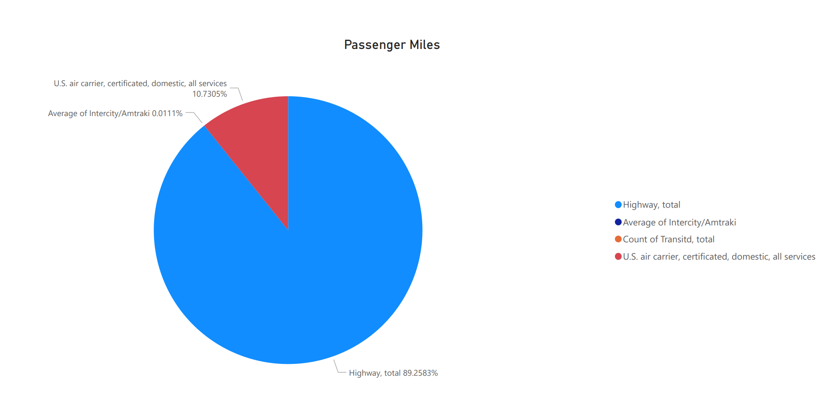
Air Vs. highway Travel
Highway travel is much larger than air travel, so is the difference in fatality percentage significant? The total passenger miles for that same time period (2010 – 2020) shows highway travel accounts for almost 90% of travel, while airlines only account for a little over 10 percent. Airline travel accounts for over 10 percent of all travel, but only .24 percent of fatalities. Other forms of travel are too small to be significant in our comparison.

Slide 5
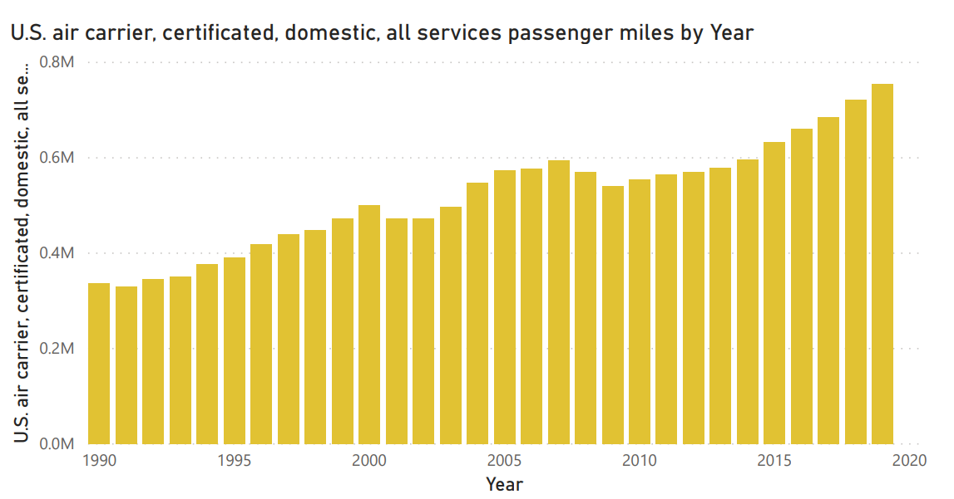
Does Increase in accidents lead to lower travel
The past 30 years shows a relatively steady upward trend in air travel. We see a dip in 2001 which is likely due to 9/11 and a slight dip in 2008 which is in alignment with a US recession but in both cases the numbers climbed back up within just a few years. There are no declines related to crashes that we can see and the trend appears to be steady enough that we would expect it to continue.

Slide 6
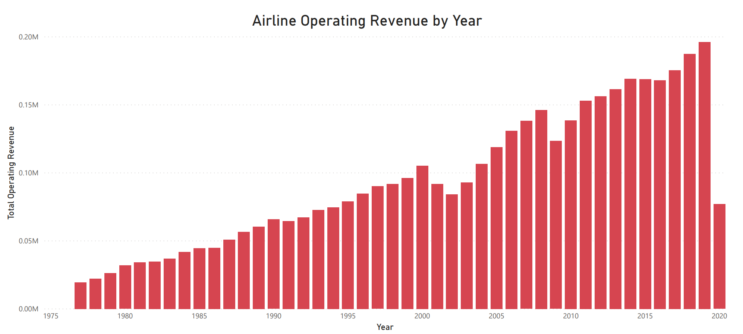
Historical Revenue
We see a trend in revenue that is pretty much identical to the trend in passenger miles with a small decline in 2001 and 2008 but rebounding in both cases. Again, we would expect this to continue and not be impacted by recent crash fears.

Slide 7
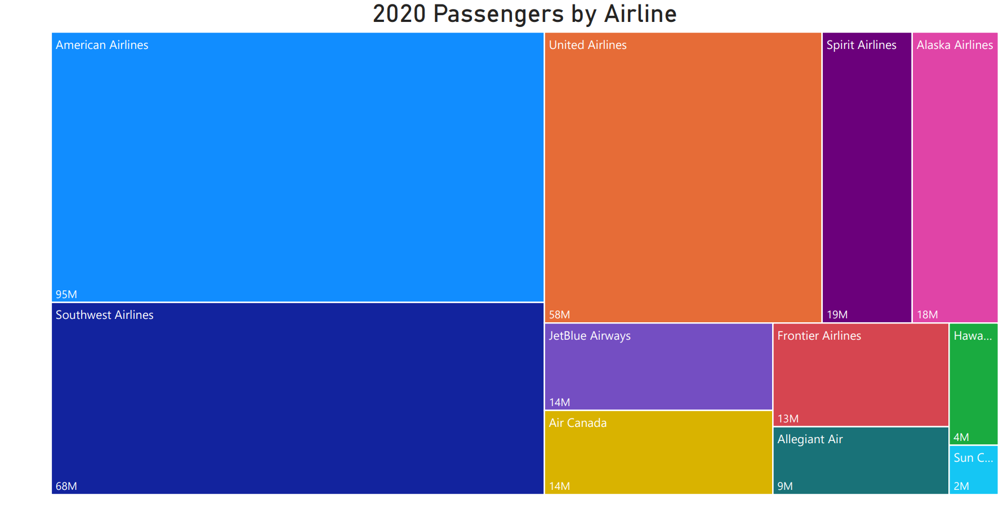
Where Does southwest stand in comparison?
In 2020, Southwest recorded the second highest number of passengers in the US, only behind American.

Slide 8
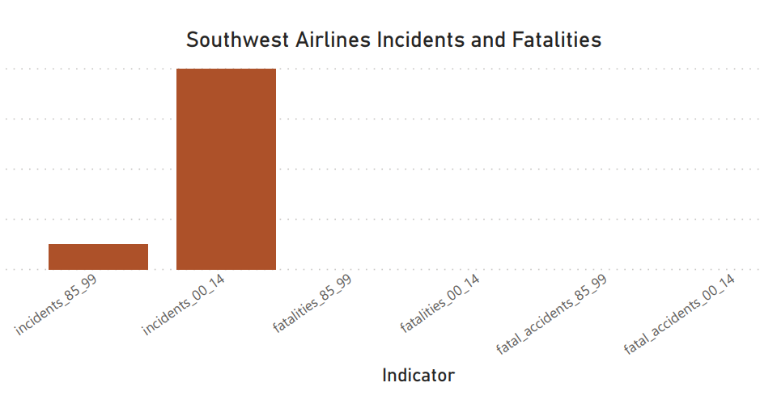
Where Does southwest stand in comparison?
In addition to having one of the largest market shares, Southwest is one of the safest Airlines to fly. From 2000-2014, we recorded ZERO fatalities and very few incidents. This is an area that we can focus our marketing on.

Slide 9
Conclusion
Based on this research, we conclude that:
Air travel is significantly more safe than highway travel
Southwest is among the safest airlines
We expect previous trends to continue

